Slide 1

STUDENT PERFORMANCE ANALYSIS USING DATA VISUALIZATION
DSA0613-DATA HANDLING AND VISUVALIZATION FOR DATA ANALYTICS
GUIDED BY:
Dr.Kumaragurubaran T
Dr.Senthilvadivu S
Department of computer science and Engineering,
Saveetha School Of Engineering
PRESENTED BY:
A.Bhavya(192424417)
A.Sai Joshitha(192424220)
Department of AIDS
Saveetha School Of Engineering
Date:[05/02/26]

Slide 2


ABSTRACT
This project focuses on analyzing student performance through data visualization techniques. Student data, including attendance, study hours, internal marks, exam scores, and subject-wise grades, is collected and preprocessed for accuracy. Using charts, graphs, scatter plots, and heatmaps, the project identifies trends, patterns, and correlations in performance. The analysis highlights strengths, weaknesses, and factors affecting academic results, providing actionable insights to support data-driven decisions and improve overall student learning outcomes.

Slide 3
INTRODUCTION
Student Performance Analysis involves studying academic data such as marks, attendance, and assessment scores.
Data visualization helps convert complex student data into easy-to-understand graphical formats.
Visual tools like bar charts, line graphs, scatter plots, and box plots highlight performance trends clearly.
It enables quick identification of students strengths and areas that need improvement.
Performance comparison across subjects, semesters, or students becomes easier through visuals.

Slide 4
OBJECTIVES
To collect and organize student academic data such as marks, attendance, and assessment scores.
To analyze student performance using graphical and visual techniques.
To identify patterns, trends, and variations in student academic performance.
To compare student performance across subjects, semesters, or academic years.
To detect low-performing students and learning gaps at an early stage.
To study the impact of attendance and behavior on academic outcomes.

Slide 5
LITERATURE REVIEW
Big Data & Student Analytics (2024)
A study in Scientific Innovation in Asia provides a state‑of‑the‑art overview of student performance analysis within big data contexts, discussing how visualization complements data preprocessing and predictive analytics for holistic performance interpretation.
Learning Analytics Dashboards Review (2024)
A systematic review synthesizes research on the design and deployment of learning analytics dashboards, showing they are widely used to support academic performance prediction and self‑regulated learning, but also noting challenges in real classroom implementations and ethical issues.
Educational Technology & Performance Outcomes (2023)
A broader review of educational technology impacts, including visualization components, found that tech tools using analytics and visual feedback often correlate with improved student engagement and outcomes.

Slide 6
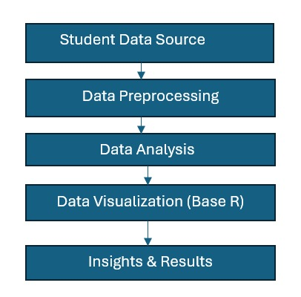
System Design / Architecture

Slide 7
Module 1: Student Academic Performance Analysis
Collects and analyzes student marks and grades
Compares performance across subjects and semesters
Identifies high and low performing students
Finds strengths and weak areas in academics
Visualizes results using charts and graphs for easy understanding
Notes:
* Collects and analyzes student marks and grades* Compares performance across subjects and semesters* Identifies high and low performing students* Finds strengths and weak areas in academics* Visualizes results using charts and graphs for easy understanding

Slide 8
MODULE-1 : Outcome
Clear understanding of each student’s academic performance
Identification of strengths and areas needing improvement
Comparison of student performance across subjects and semesters
Early detection of low-performing students
Improved academic decision-making using visual insights

Slide 9
Module 2 - Student Behavior & Attendance Impact on Performance
Collects data on student attendance and behavioral records
Analyzes the relationship between attendance and academic performance
Studies the impact of student behavior on overall performance
Identifies students at risk due to poor attendance or behavior
Visualizes attendance, behavior, and performance trends using charts and graphs

Slide 10
MODULE-2 : Outcome
clear insight into how attendance affects academic performance
Understanding the influence of student behavior on results Early identification of students at risk due to low attendance or behavior issues
Improved monitoring of student engagement and discipline Better decision-making for interventions and student support

Slide 11
Methodology
Collect student data such as marks, attendance, behavior, and assessment scores.
Clean and preprocess the data by handling missing values and errors.
Organize and integrate data from different sources into a single dataset.
Perform basic statistical analysis to understand performance patterns.
Create visualizations (bar charts, line graphs, box plots, scatter plots).
Analyze trends, comparisons, and relationships in the visualized data

Slide 12
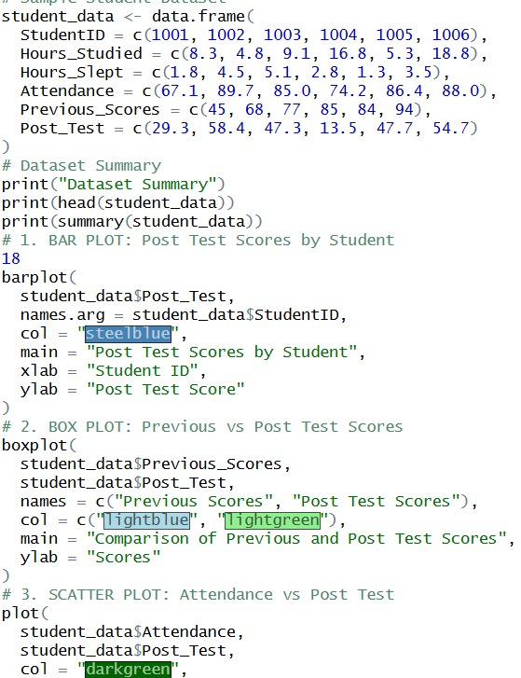
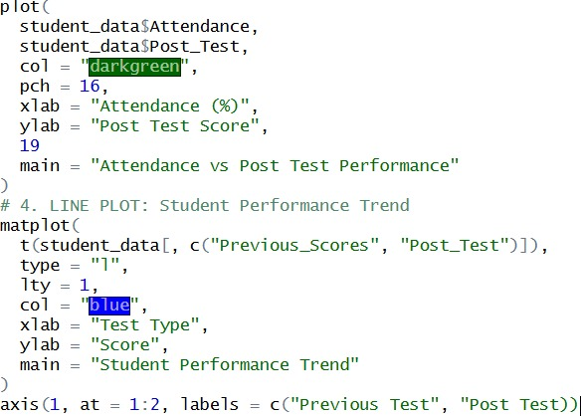
Implementation

Slide 13
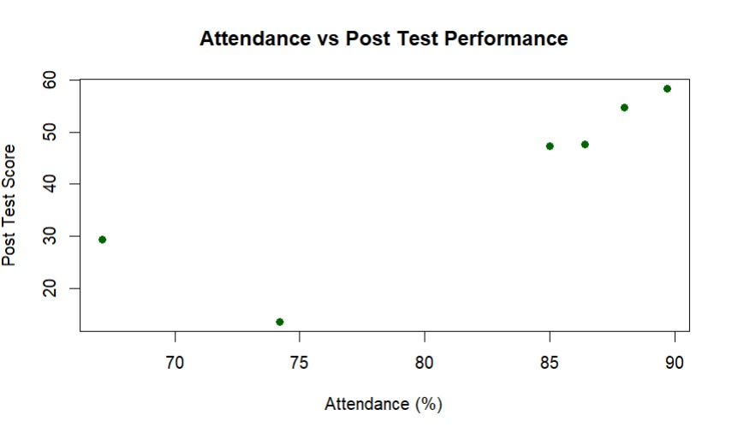
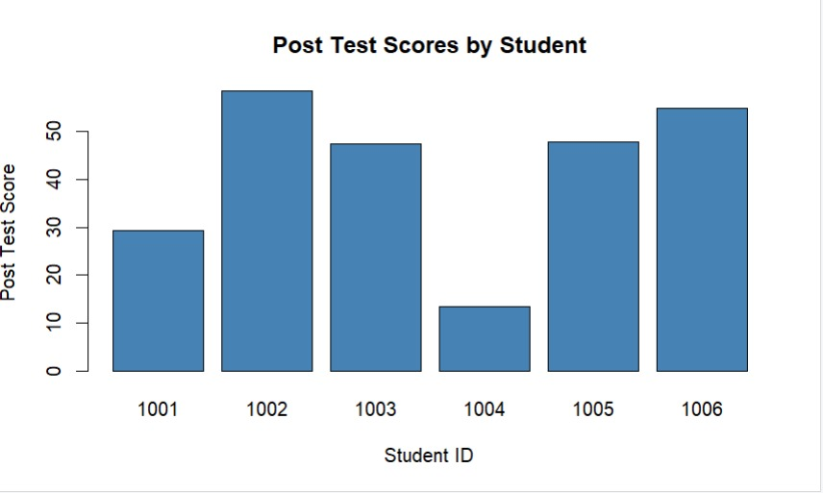
OUTPUTS
BAR PLOT
SCATTER PLOT

Slide 14
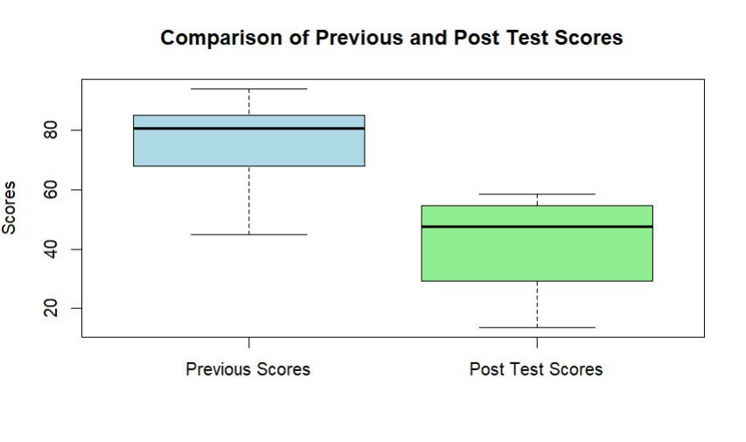
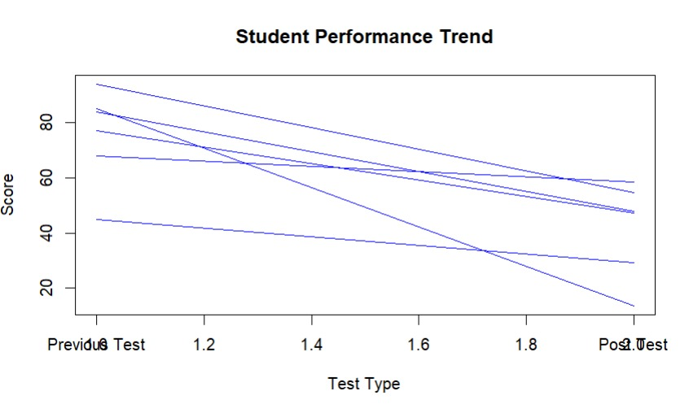
OUTPUTS
LINE PLOT
BOX PLOT

Slide 15
Results & Discussion
Visual analysis clearly shows variations in student performance across subjects and semesters.
Students with higher attendance generally demonstrate better academic performance.
Behavioral issues are observed to negatively impact overall academic results.
Data visualizations help in easily identifying high-performing and low-performing students.
Trends highlight specific subjects where students consistently struggle.

Slide 16
Future Scope
Use of learning analytics and big data platforms for large-scale student data processing.
Real-time dashboards for continuous monitoring of academic and behavioral metrics.
Incorporation of AI-driven recommendation systems for personalized learning paths.
Advanced data mining techniques to identify hidden patterns and correlations.
Integration with Learning Management Systems (LMS) for automated data collection.

Slide 17
Challenges & Limitations
Incomplete or missing student data can affect analysis accuracy.
Data quality issues such as errors and inconsistencies may lead to misleading results.
Visualization results depend heavily on the correctness of input data.
Behavioral data is often subjective and difficult to measure accurately.
Limited historical data reduces the ability to identify long-term trends.
Privacy and security of student data must be carefully maintained.

Slide 18
Conclusion
Student Performance Analysis using Data Visualization provides an effective approach to understanding academic outcomes by transforming raw student data into meaningful visual insights. Data visualization simplifies complex datasets, enabling educators to make informed and timely decisions. Despite challenges related to data quality and privacy, the approach enhances monitoring, early intervention, and overall academic planning. Overall, data visualization serves as a powerful tool for improving educational performance and supporting data-driven academic management.

Slide 19
References
Malik, S., Patro, S.G.K., & Mahanty, C. Advancing educational data mining for enhanced student performance prediction: fusion of feature selection and ensemble techniques. Scientific Reports, 15, 8738 (2025).
Guevara-Reyes, R., Ortiz-Garcés, I., Andrade, R., Cox-Riquetti, F. & Villegas-Ch. W. Machine learning models for academic performance prediction: interpretability and application in educational decision-making. Frontiers in Education, 10:1632315 (2025).
Kalita, E., Oyelere, S.S., Gaftandzhieva, S. et al. Educational data mining: a 10-year review. Discover Computing 28, 81 (2025).

Slide 20
THANK
YOU !!

